Slide 1

Creating your research poster
How to create a poster and write an abstract
Dr. Lauren Clark, Director of Undergraduate Research

Slide 2
Presentation overview
What is a poster session?
Summer Research Symposium
Tips for developing your poster
Presenting your poster
Abstract writing
Activity: abstract writing

Slide 3
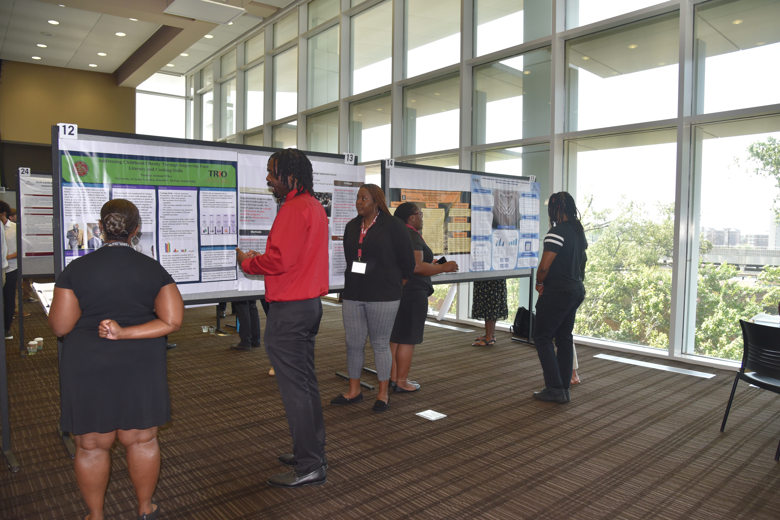
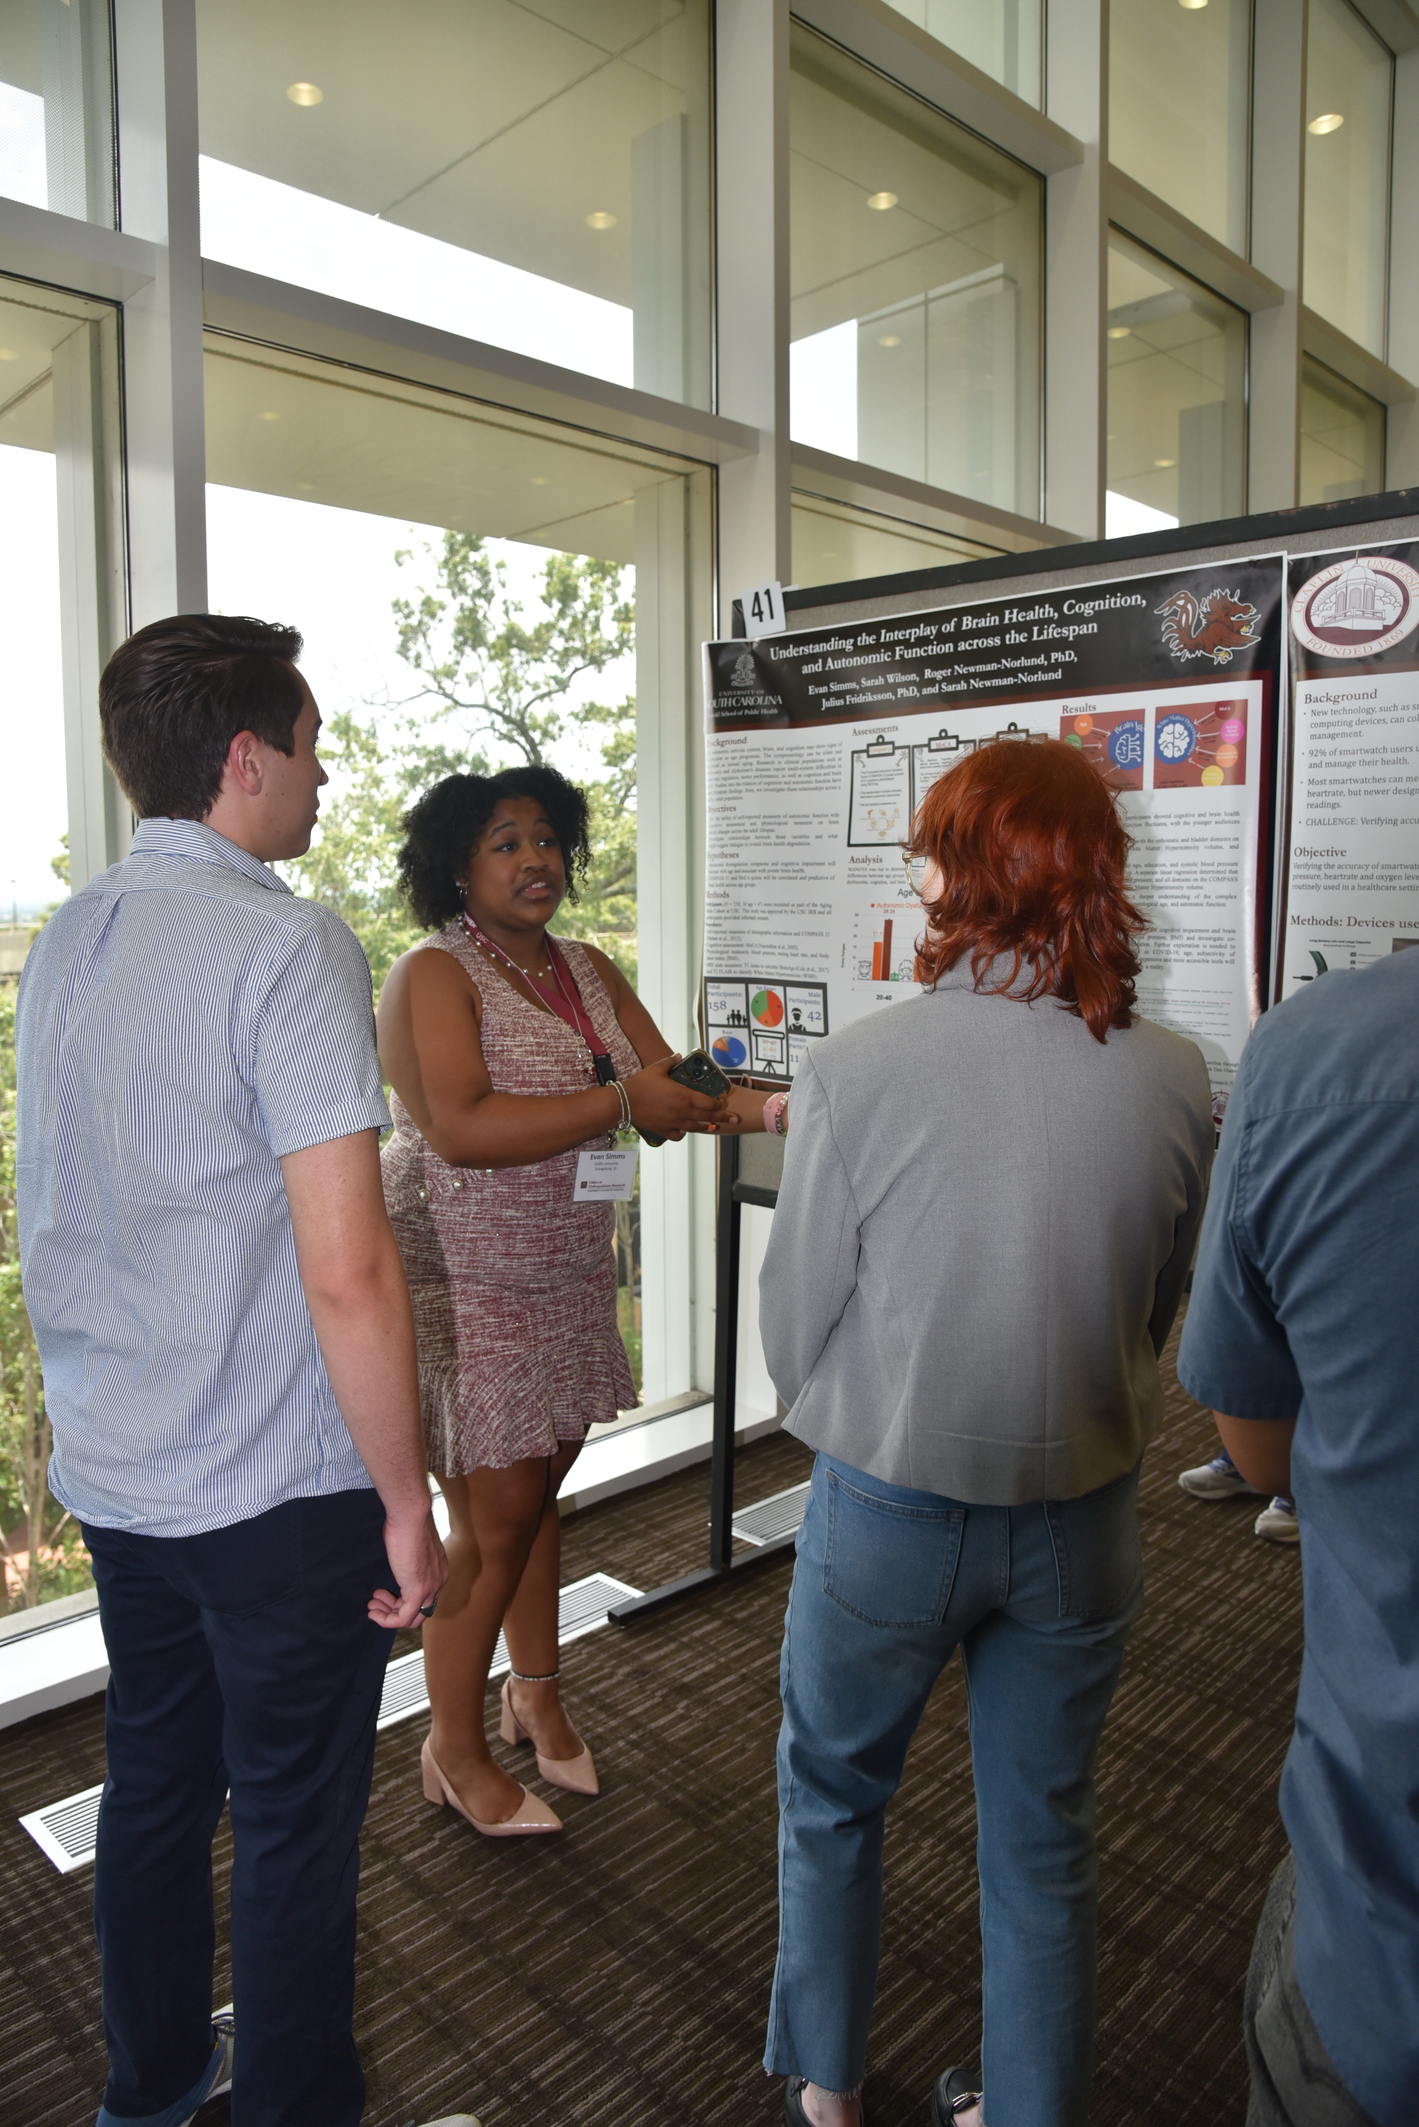
What is a poster session?

Slide 4
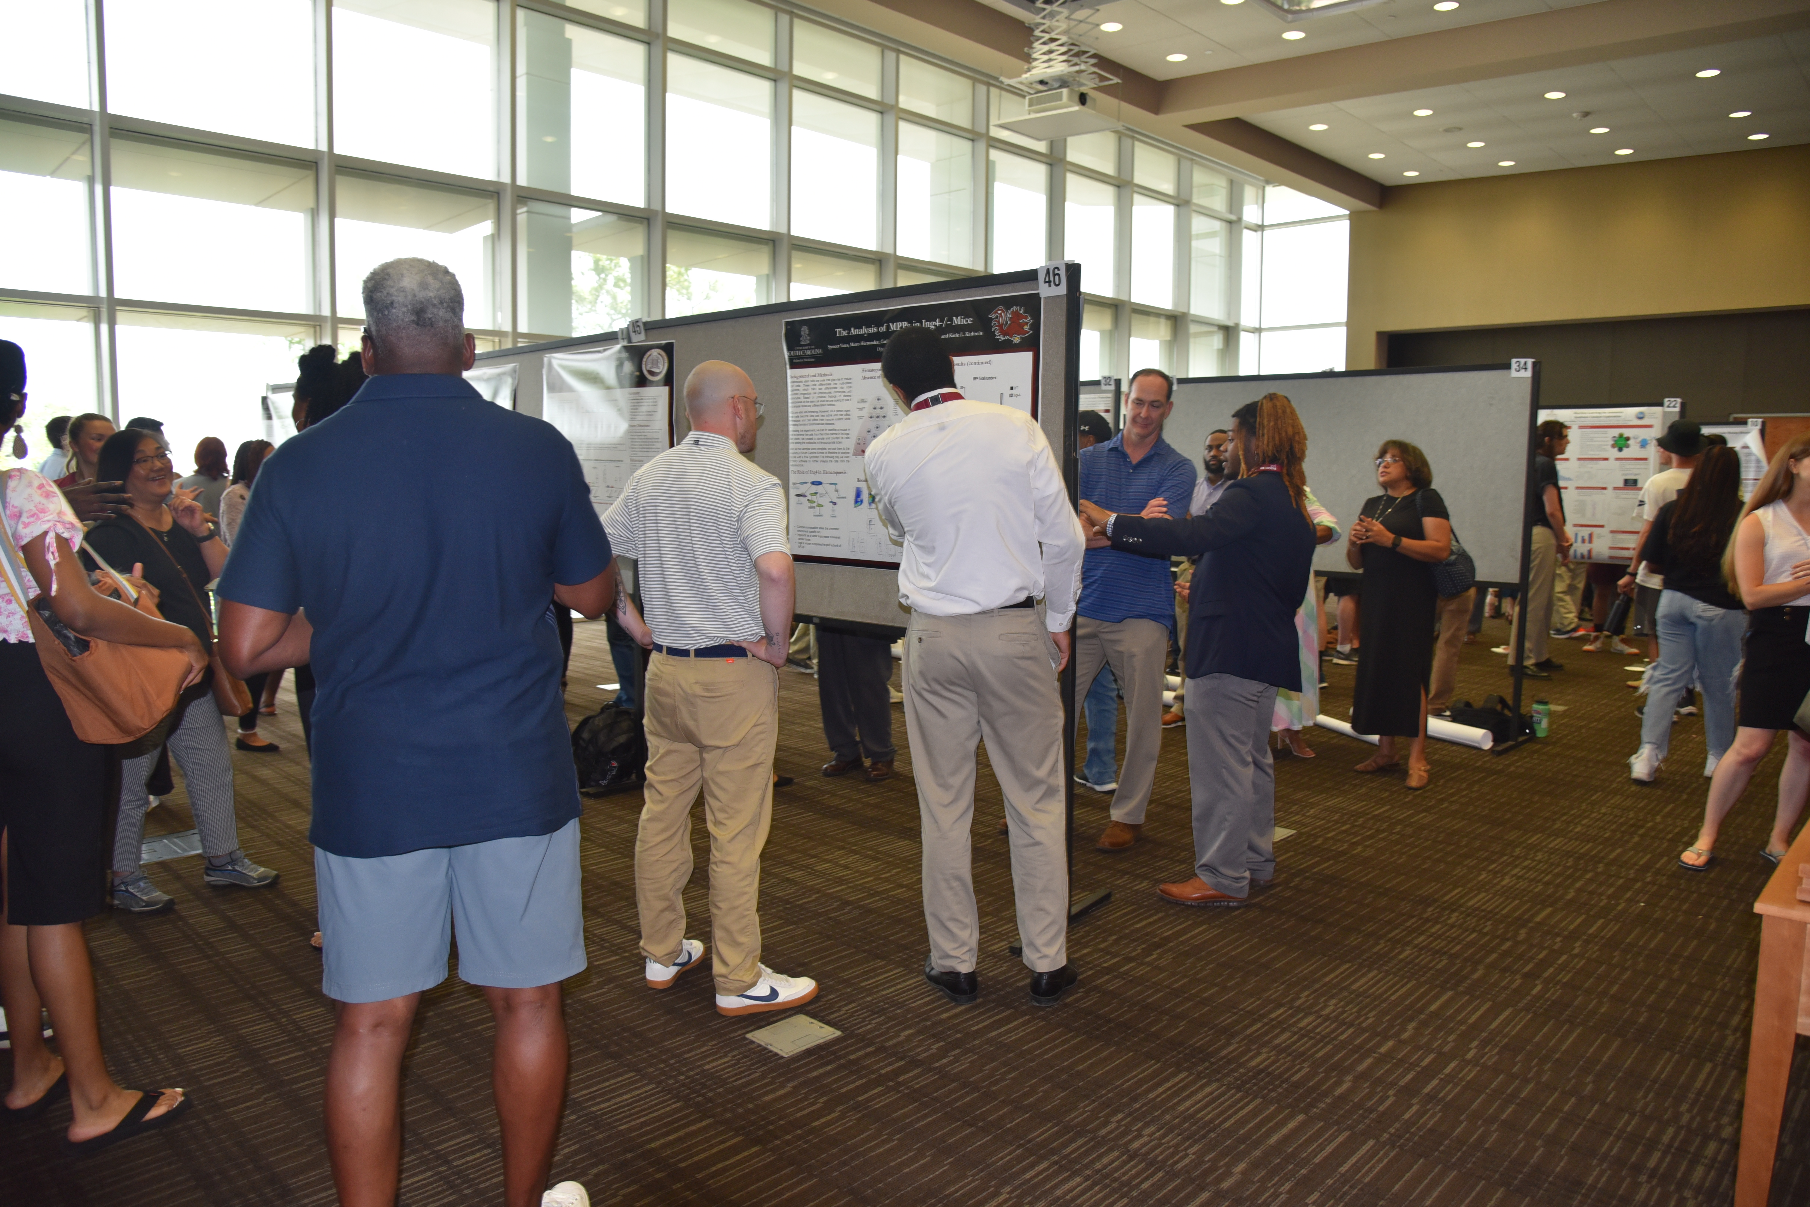
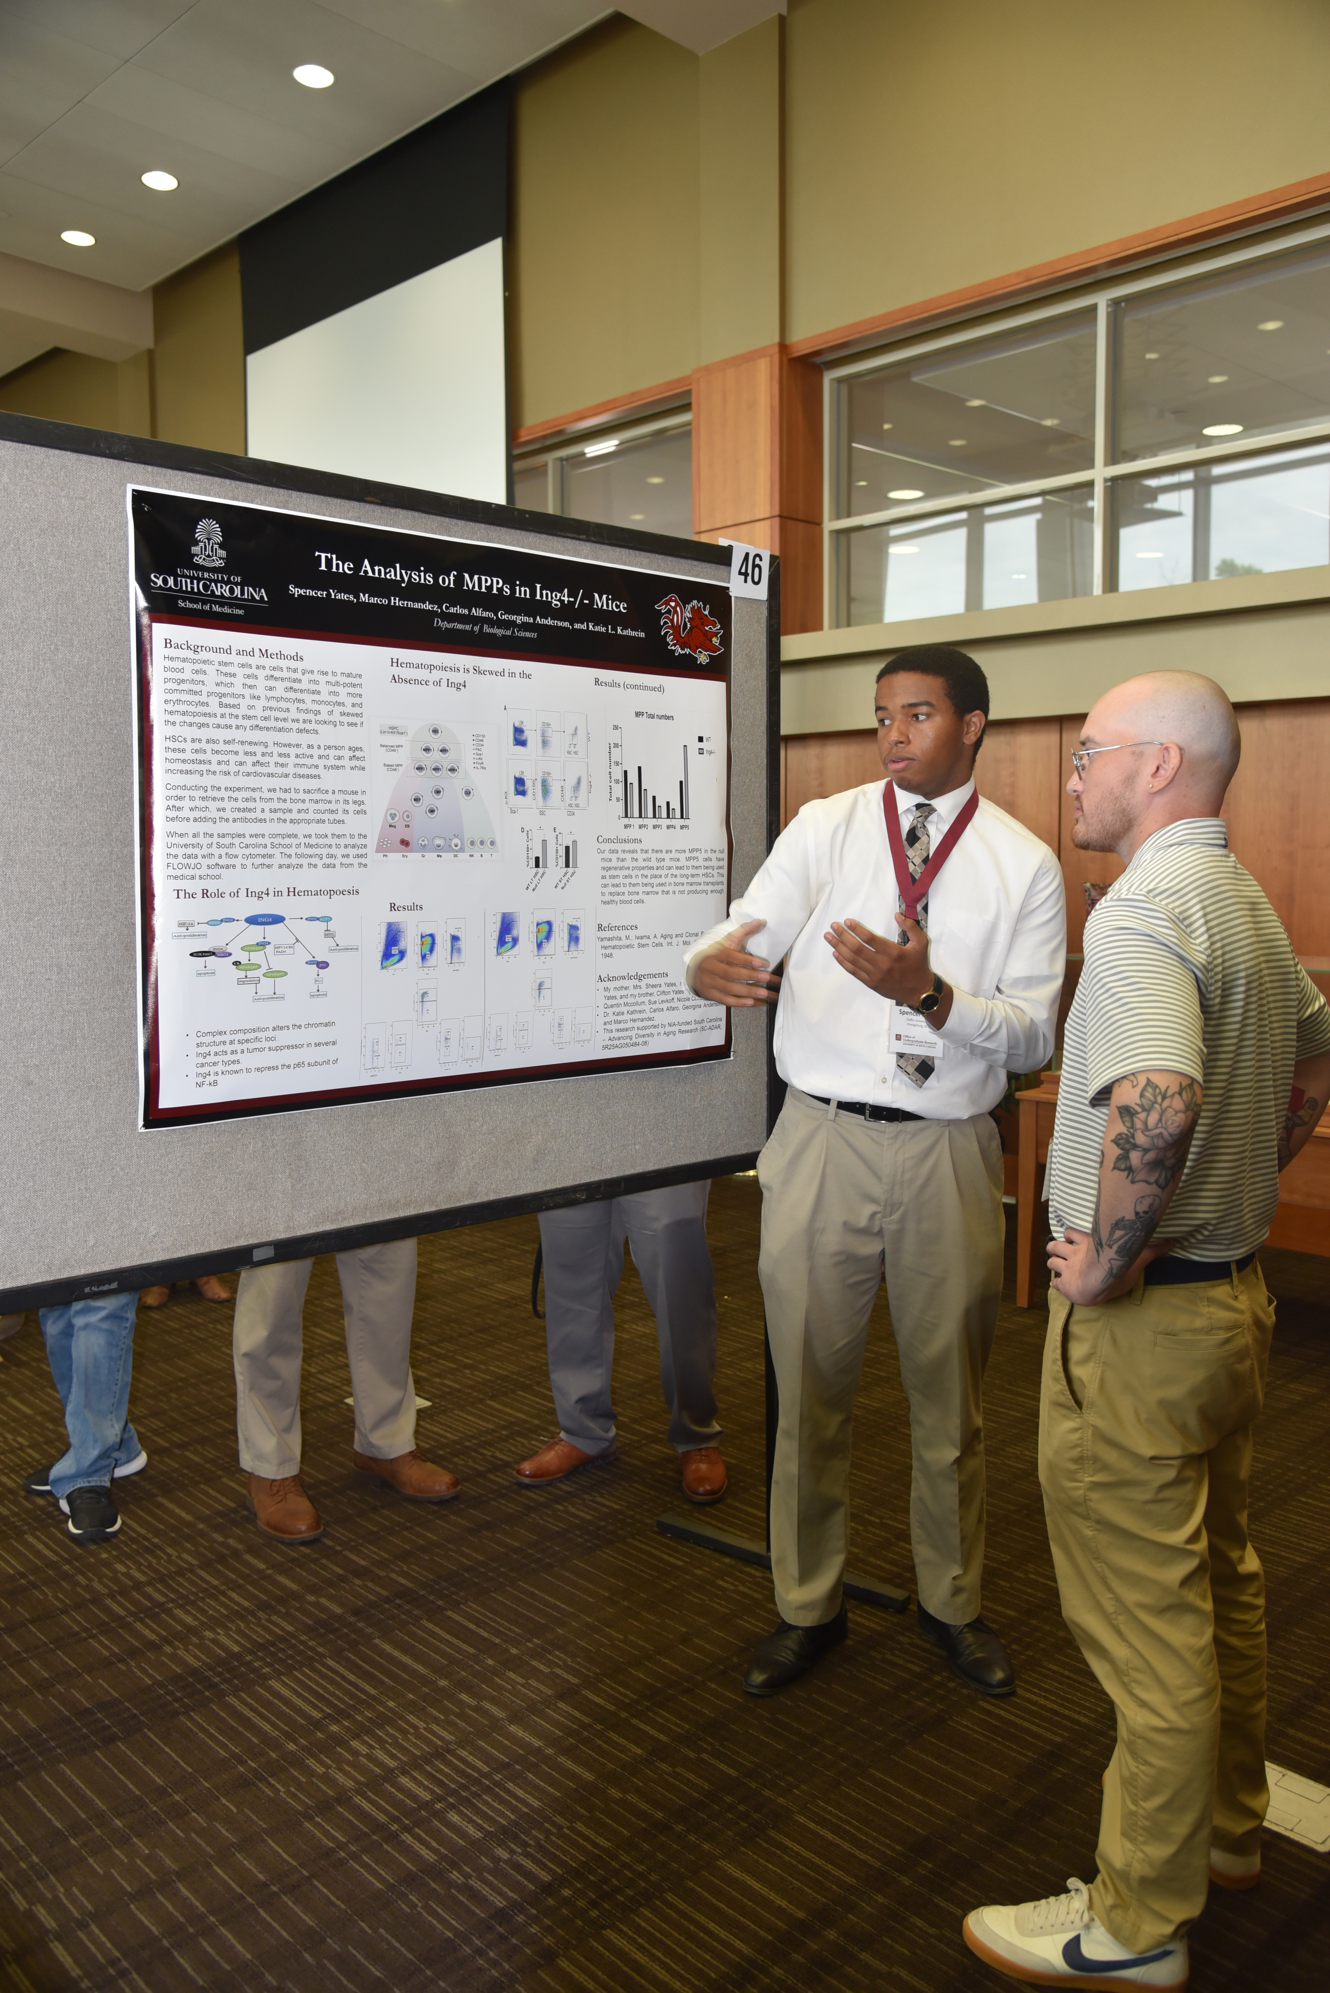
What is a poster session?

Slide 5
Summer research symposium
Thursday, July 31, 2025
Hollings Program Room in Thomas Cooper Library
Morning and Afternoon Sessions
Research Programs will be grouped together

Slide 6
Details
Nametags at registration table
2 posters per side of the display board
Poster dimensions – no larger than 48 in x 48 in - 36 in high by 48 in wide - 48 in high x 42 in wide
4 t-pins provided to hang poster - Angle t-pins down (not straight through)

Slide 7
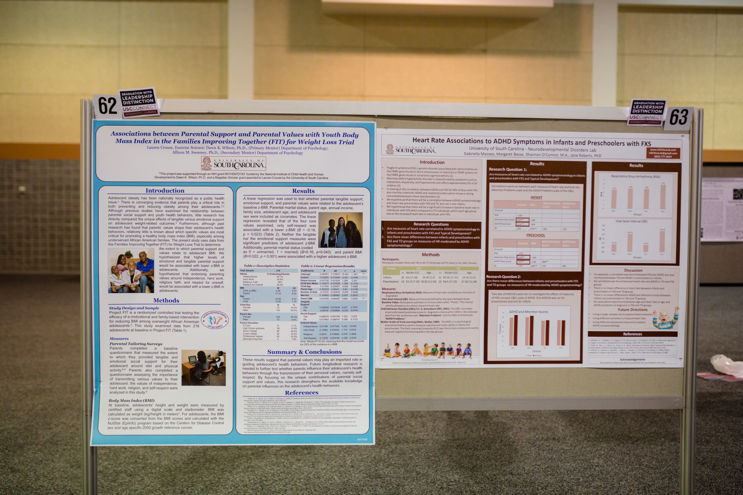
2 posters per side of display board

Slide 8
Registration
Registration is open and deadline is July 1
Abstracts not required for registration
Registration will ask for your name and information, mentor and information and a project title (you do not have to submit an abstract to register!)
Make sure that your faculty mentor approves of your title, co-presenters and mentors before you submit the registration form
If you need to make a change to your registration form, email our@sc.edu

Slide 9
Successful posters
Convey a clear message
Include high-impact visual information
Use minimal text

Slide 10
Great posters are …
Readable – clear language and correct grammar
Legible – text is readable from 5 feet away
Well-organized – information grouped logically and in a visually appealing way
Succinct – you have 10 seconds to grab the attention of attendees!

Slide 11
Content – what to include?
Abstract (ask your mentor if this should be included)
Introduction / Background (what is the context for your work)
Hypothesis / Research Question
Methods (What did you do)
Results (What did you find)
Discussion (what do your results mean – interpret the data)
Conclusions (What you learned)
Future plans or next steps
References (Works cited)
Acknowledgements (funding source)

Slide 12
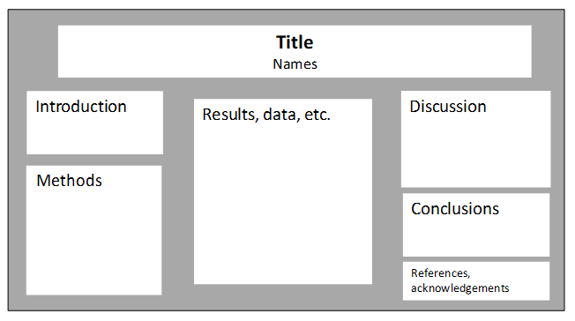
Horizontal Layout

Slide 13
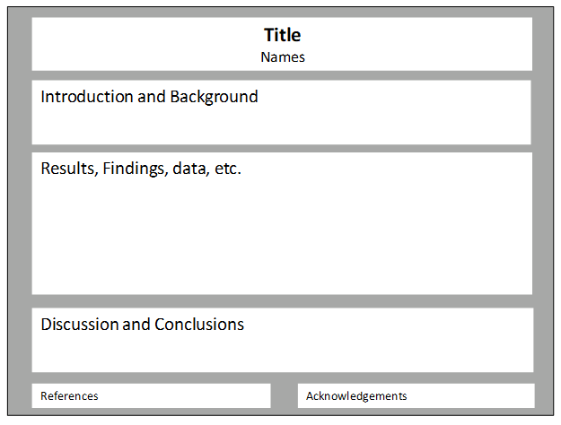
Vertical layout

Slide 14
University poster templates
Available on USC Communications and Marketing website
Brand Toolbox -Resources -Templates -Research Posters
https://sc.edu/about/offices_and_divisions/communications/toolbox/resources/templates/research_posters/index.php

Slide 15

Research Poster 3-Column Template
Research Poster: Title of Presentation
Authors and Co-authors
University of South Carolina, affiliations for other authors
How to Use this Template
Your Poster Content and Presentation
Type Size and Section Headers
Choose the template that best accommodates your communications objectives. There are three and four column templates.
Copy text box to other locations on poster as needed
Poster dimensions are 36” tall by 48” wide
You can copy and paste from an existing presentation to the poster template or enter the information directly onto the template
Try for an even balance on your posters
Use graphs and bar charts to represent data when possible
Accent Colors: When possible, use these secondary colors when you create your charts and graphs (Brand Toolbox)
Type text inside the text boxes
Increase and decrease your view sizes as needed to see all or individual sections of poster.
Do not use a font smaller than 24 except than for captions under pictures
Make sure to keep your relevant text under the proper section headers
Highlighted box
This box can be used to highlight a particularly important element or conclusion.
Use only one highlighted box per layout.

Slide 16
Research Poster Template
Research Poster: Title of Presentation
Authors and Co-authors
University of South Carolina, affiliations for other authors
How to Use this Template
Your Poster Content and Presentation
Type Size and Section Headers
Highlighted box
Choose the template that best accommodates your communications objectives. There are three and four column templates.
Copy text box to other locations on poster as needed
Poster dimensions are 36” tall by 48” wide
You can copy and paste from an existing presentation to the poster template or enter the information directly onto the template
Try for an even balance on your posters
Use graphs and bar charts to represent data when possible
Accent Colors: When possible, use these secondary colors when you create your charts and graphs (Brand Toolbox)
Type text inside the text boxes
Increase and decrease your view sizes as needed to see all or individual sections of poster.
Do not use a font smaller than 24 except than for captions under pictures
Make sure to keep your relevant text under the proper section headers
This box can be used to highlight a particularly important element or conclusion.
Use only one highlighted box per layout.

Slide 17
You can get started now
Look around at examples of posters (hallways, labs, etc.)
Ask if your research program or group uses a specific template
Once you have a template, start filling in background information, methods, etc.
Work on the poster as you go through the project, rather than starting it during the last week

Slide 18
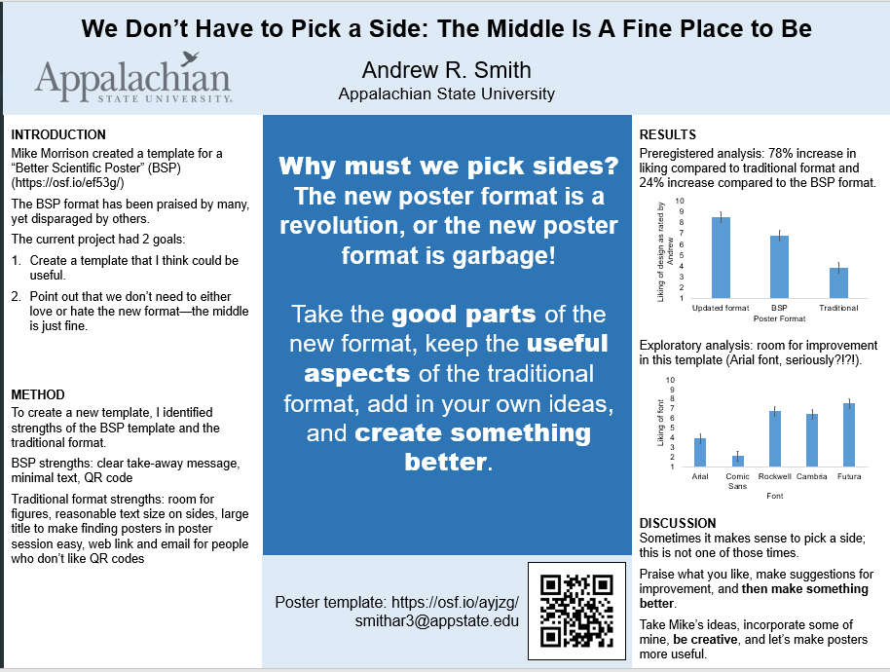
The “Better poster” format

Slide 19
Planning your poster
Discuss with your mentor
Get approval for template
Identify your message – what is the takeaway?
What information is critical to understanding this message?
Outline your message and supporting information (abstract is a good starting point)
Map your outline on paper

Slide 20
Information outline
Clarify your message – what question are you answering?
Which results support the message?
What information is needed to understand the results and how you got those results?
Are there figures that can help explain or support the message?
Discuss/interpret the results – what does it mean?
Are there any future research areas or next steps?

Slide 21
Poster tips
Do not duplicate full text of a paper onto your poster
Hit the high points
You can make the poster available to attendees by using a QR code
Avoid background pictures

Slide 22
Poster Text
Use an easy-to-read font for all text at a minimum size of 24pt.
Avoid ALL-CAPS for extended blocks of text, as they are HARD TO READ IN LARGE BLOCKS OF TEXT.
Use blocks of text sparingly
Use section headers
Use lists/bullets
Use “standard” fonts so that you do not have printing issues
If using symbols, save poster as a PDF before printing

Slide 23
Poster images
Check image quality before printing
Do not use copyrighted images

Slide 24
Presenting your poster
Prepare a 30 sec, 2 min, and 5 min overview of your project
Introduce yourself
Explain the context of your research question and why it is relevant/important (background)
Explain your objective and what you did (methods).
What were your results (explain figures and tables)?
What do the results mean – what is the significance of your research project? Put results in context – discussion.
Questions you MUST be able to answer:
So what? Why should I care?

Slide 25
Presenting your poster
Consider your audience!
Be prepared to talk with experts and non-experts
Know definitions of every word on poster and be able to define acronyms
Critically review your poster for potential questions – anticipate questions people might ask
Don’t be scared of “I don’t know,” “I hadn’t thought of that,” and “Great idea!”
Don’t assume knowledge!

Slide 26
Presenting your poster
Engage the viewer
Invite the viewer to ask questions or offer to “walk them through it”
Use the poster as a visual aid to emphasize points and share information (point to things, use your poster to help your discussion)
Don’t stand directly in front of your poster
Be friendly and welcoming!

Slide 27
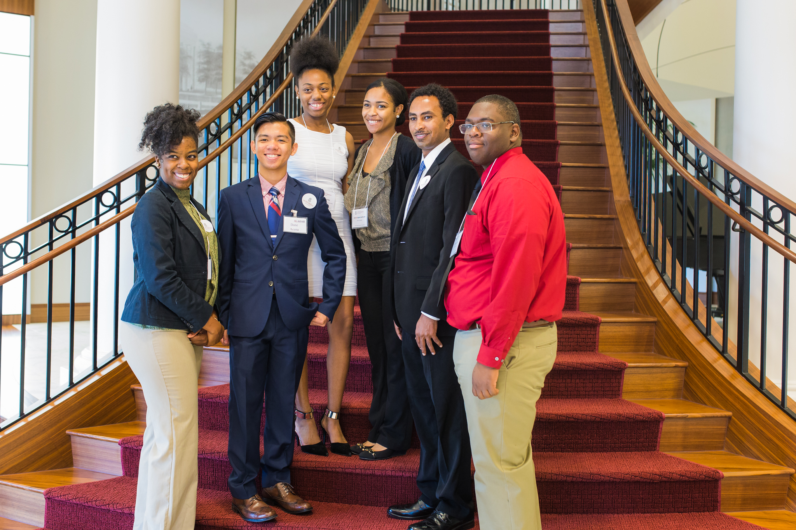
Presenting your poster
Dress professionally
Business casual (suits not required)
Comfortable shoes (remember you will be standing in one place for over an hour!

Slide 28


Slide 29
Questions about posters?

Slide 30
Writing an abstract
Introduction to abstract-writing
Provide an opportunity to start a draft of your abstract
By writing an abstract, you have outlined the essential information needed for your poster!

Slide 31
What is an abstract?
The abstract is a brief overview of your selected type of work.
It is typically a condensed version of longer piece of writing that highlights the major points covered, while concisely describing the content and scope of the work.
Abstracts are basically an outline of your project in sentences.

Slide 32
What do abstracts convey to reader?
Why you did it (Background)
What you did and how you did it (Methods)
What you found (Results)
What it means (Discussion)

Slide 33
Review the sample abstracts
Select one abstract
Identify the following information in each abstract
-Why they did it
-What they did and how they did it
-What they found
-What it means

Slide 34
What if…
My project/research is still in progress so my results aren’t ready to be shared - what do I do?
No problem! Do you have anticipated results? Share those. If not, focus on the other sections of abstract such as background, why and how. You can also explain the methods and any issues with the methods.

Slide 35
Abstract style
Be concise – use the least number of words to convey the information
Use active verbs
If submitting an abstract to a conference, there are often abstract word limits – pay close attention to that
Do not use abbreviations without defining them
Avoid jargon

Slide 36
Make the abstract readable
Do not use abbreviations without defining them
Avoid jargon
Write in third person singular
Use complete sentences

Slide 37
Time to write
Next slides have questions about your project
Write down as much as you can about your project
The amount of time per slide is noted

Slide 38
Introduction – 2 minutes
What is your project about?
Why is this project interesting and/or important?
What is the scope of the project?
What is your hypothesis or research question?
How does this topic fill a gap in the current knowledge in your research area?

Slide 39
Methods – 2 minutes
How are you collecting samples or data?
What are you testing?
What methods are you using?

Slide 40
Results – 2 minutes
If your project is not complete, what do you think you will find?
What did you find when you performed your experiment or survey?
How will you present your data? Tables, figures, images?

Slide 41
Discussion and Conclusions – 3 minutes
Are your results consistent with your initial hypothesis? Why or why not?
What is your interpretation of what these results mean?
Why should others be interested in your findings?
What are the implications for future research?

Slide 42
Review and revise
Read the abstract: How does it sound? How does it flow?
Revise to improve transitions.
Eliminate any unnecessary information.
Strive for unity, coherence and emphasis.
Always have someone else review, including your faculty mentor.

Slide 43
Always ask for help
Others in your research group can review your title and abstract
Faculty mentor should be final approver

Slide 44
Questions about abstracts?

Slide 45
Thanks!
Dr. Lauren Clark
Director of Undergraduate Research
clarkll@mailbox.sc.edu

