Slide 1

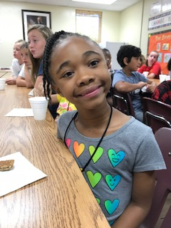
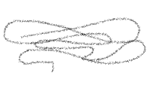
ART by the numbers

Slide 2
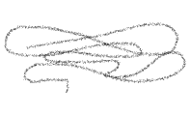
ART by the numbers/well-being
69
percent of Americans believe the arts “lift me up beyond everyday experiences”
73
percent of Americans feel the arts give them “pure pleasure to experience and participate”
81
percent of Americans say the arts are a “positive experience in a troubled world”

Slide 3
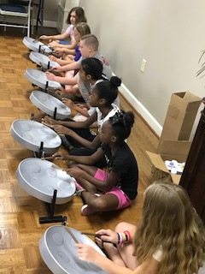
ART by the numbers/dei
72
percent of Americans believe “the arts unify our communities regardless of age, race, and ethnicity”
73
percent agree that the arts “helps me understand other cultures better”
a perspective observed across all demographic and economic categories

Slide 4
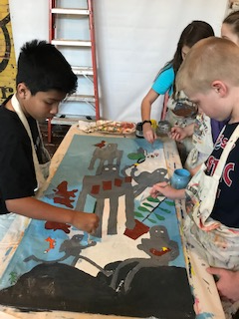
ART by the numbers/academic performance
GPAs, standardized test scores, and
college-going rates
drop-out rates
Academic benefits are reaped by students regardless of socio-economic status. Yet, the Department of Education reports that access to arts education for students of color is significantly lower than for their white peers.

Slide 5
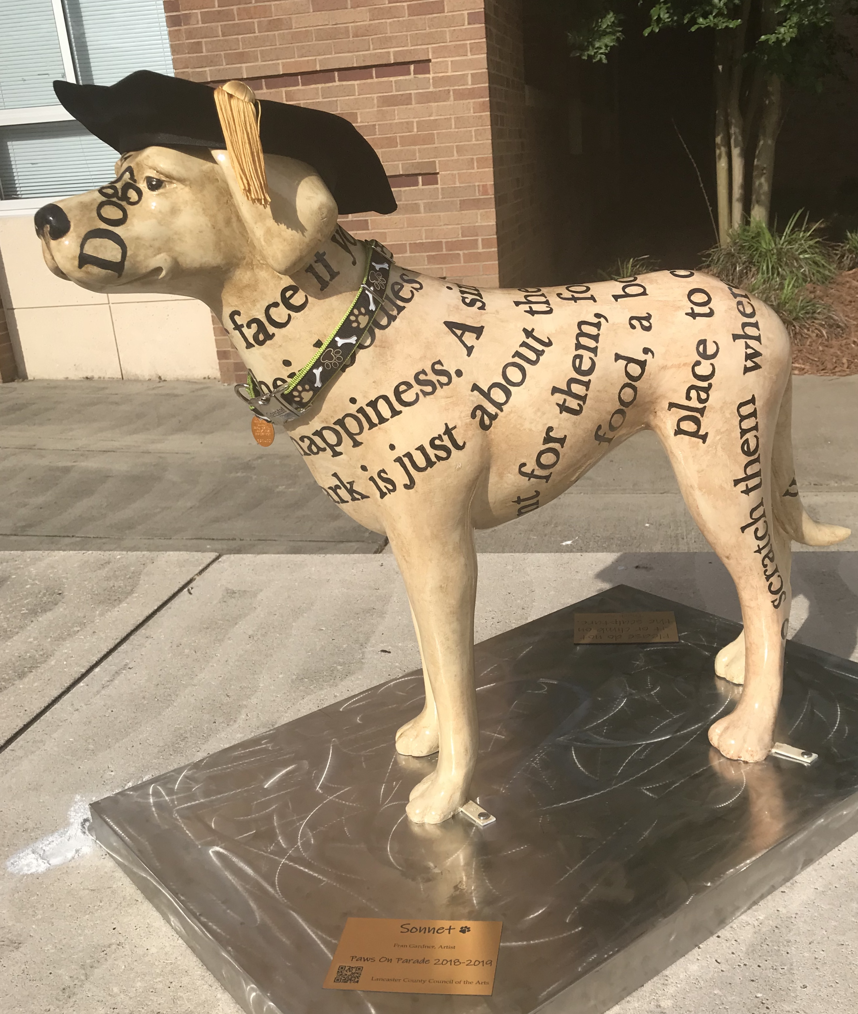
ART by the numbers/academic performance
91
percent of Americans believe that arts are part of a well-rounded education

Slide 6
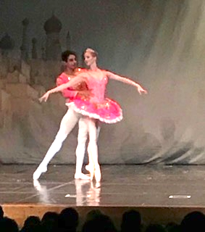


ART by the numbers/economy
4.6
million jobs in US Arts non-profits
166
Billion $ in economic activity

Slide 7
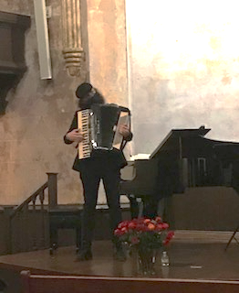
ART by the numbers/local economy
64
124
Arts related businesses that employ
Does not include art educators… Lancaster has 64
in the public schools!
people in Lancaster County
56
199
Arts related businesses that employ
people in Kershaw County
351
2396
Arts related businesses that employ
people in York County

Slide 8
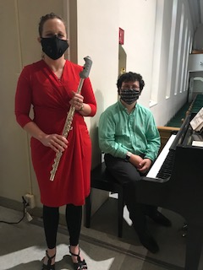
ART by the numbers/creative industries*
*Creative Industries are arts businesses that range from nonprofit museums, symphonies, and theaters to for-profit film, architecture, and design companies.
673,656
businesses in the US involved in the creation or distribution of the arts
4.01
percent of all businesses in the US are involved in the creation or distribution of the arts
2.04
percent of all employees in the US are involved in the creation or distribution of the arts/7,944,000 people

Slide 9
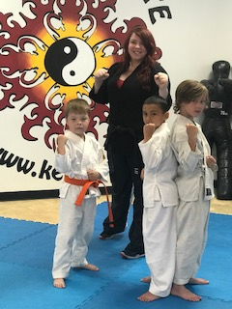
ART by the numbers/social impact
civic engagement
child welfare
social cohesion
poverty rates

Slide 10
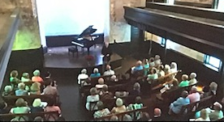
ART by the numbers/healthcare
50
Percent of US healthcare institutions provide arts programming for patients, families, and even staff
78
percent who have art programs report shorter hospital stays, better pain management, and less medication

Slide 11
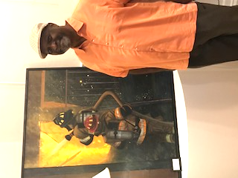
ART by the numbers/military health and well-being
4th
The arts heal the mental, physical, and moral injuries of war for military servicemembers and Veterans, who rank the creative arts therapies in the top 4 (out of 40) interventions and treatments.

Slide 12
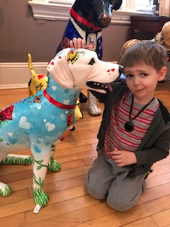
ART by the numbers
The arts are a fundamental component of healthy communities strengthening them socially, educationally, and economically — benefits that persist even in difficult social and economic times. They ennoble and inspire us, fostering creativity, goodness, and beauty. The arts bring us joy, help us express our values, and build bridges between cultures.
The arts are fundamental to our humanity.

Slide 13
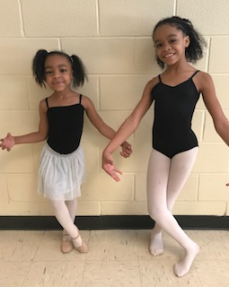
ART by the numbers
Works Cited: Americans for the Arts
americansforthearts.org
Artists involved in this
presentation:
Debbie Jaillette, photographer and musician
Fran Gardner, designer and visual artist
Eric Grace, designer/video production manager
Lisa Knox, LCSD data and musician
Lisa Hammond, Town/Gown organizer and poet
Over 50 people who participated as on-camera and behind camera talent

