Slide 1

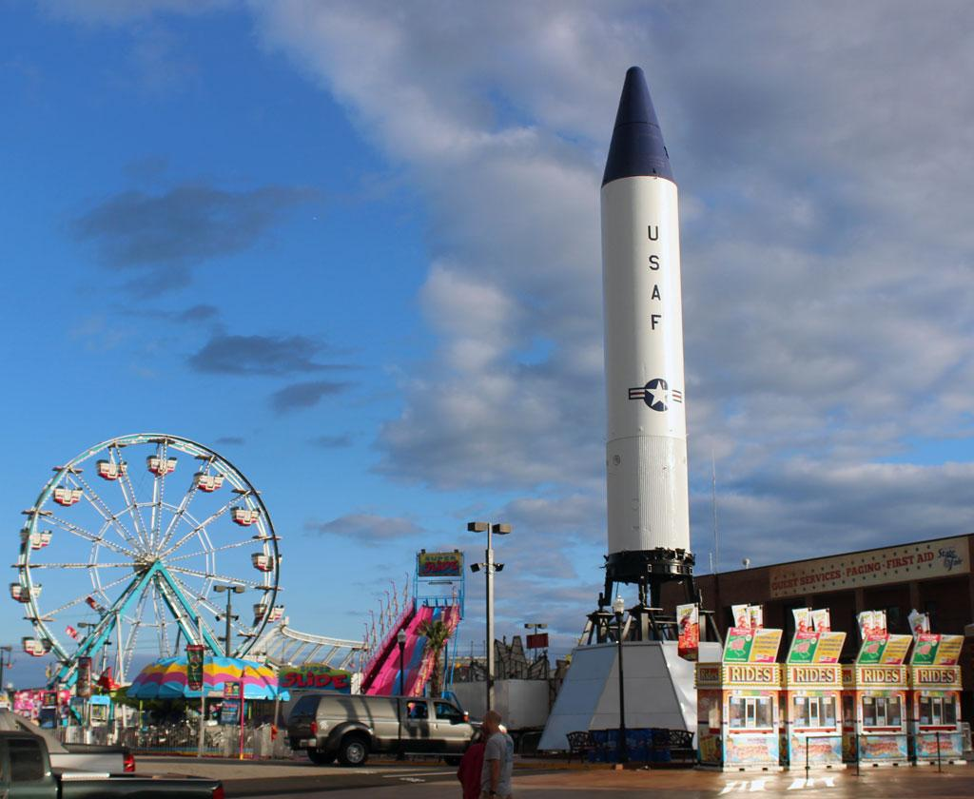

Midway Physics Day Teacher Training
September 30th , 2025
Department of Physics and Astronomy

Slide 2


Slide 3
Outline for Training
Midway Physics Day Description​
Practical Considerations​
Preparing a lesson plan​
Executing Midway Day Successfully​
Discussion​
Q and A

Slide 4
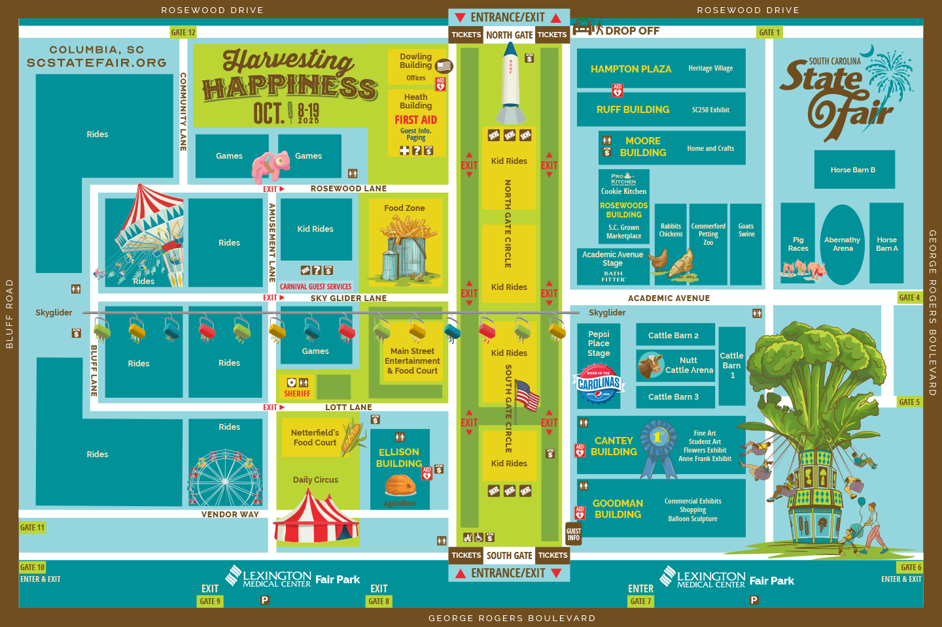
USC Physics Demonstrations Location
Academic Avenue Stage

Slide 5
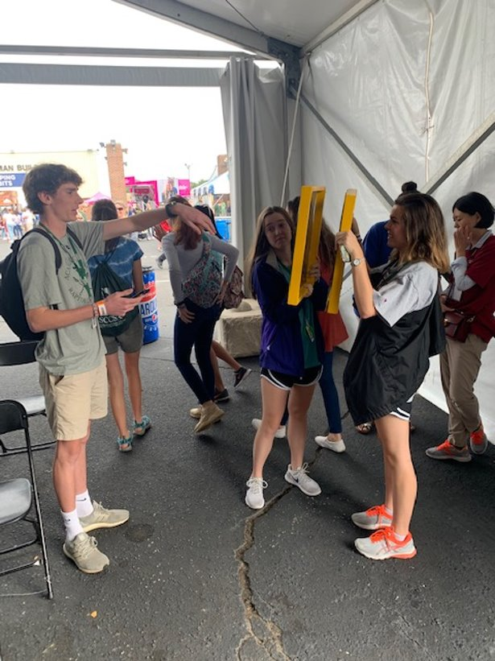
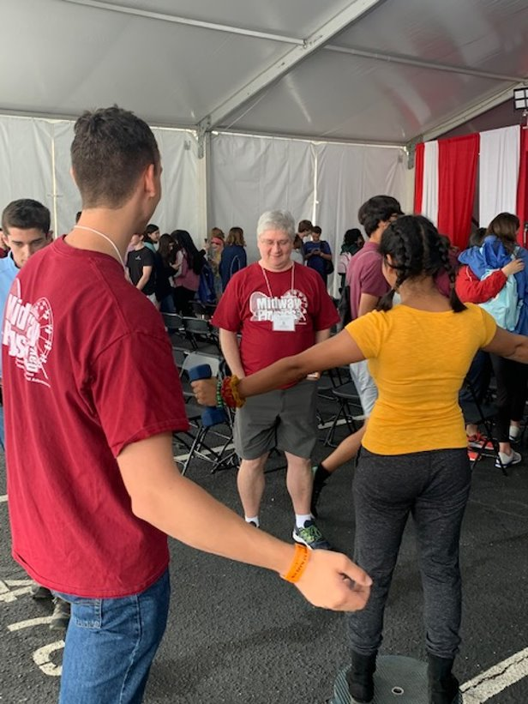
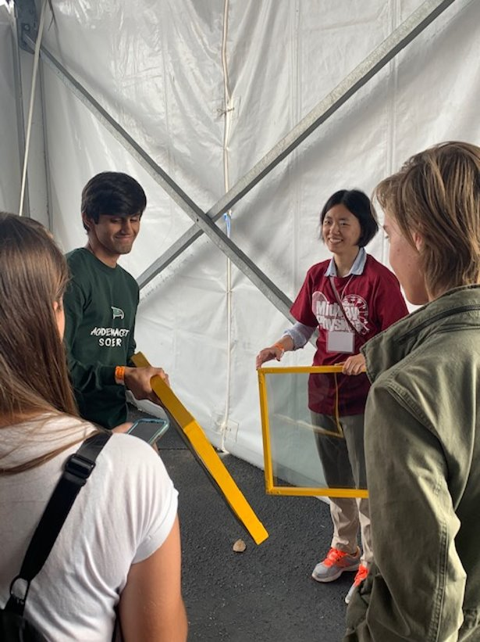
USC Physics Mentors
We work with students and teachers!

Slide 6
USC Midway Agenda
Timeline
09-11 am Prep for Event​
11-12 pm Midway morning fun​ **Check-in** and hands-on demonstrations​
12-2 pm Ride and ​Measure
We will have our mentors at different rides to help
What is YOUR schedule? ​
Plan activities for the bus ride to and from the fair.​
**Check-in**
Plan lunch time meeting – analysis, group coordination.​
Plan some free time for the students.

Slide 7
Demonstrations 11-noon
Plan activities related to the demonstrations.
Ex: Students must participate in and explain 2 demos.
Figure Skating Spin on a Rotating platform
Bike Wheel Gyroscope
Slinky Wave
Bouncing Ball Rocket
AirZooka
Magnetic Ring Launcher (Electromagnetic Forces)
Magnetic Braking Tubes
(Eddy Currents )
Crank up the Light (Magnetic Power Generator)
Liquid Nitrogen Demonstrations
Sun Spotter
Bright/Dark Windows
(Polarizer Sheets)
Sugar Water Color Wheel
Optics Station Demos (Thorlabs)
Superconducting Levitation
Have students participate in demos while you check in.
Use the Academic Avenue Stage as “home-base”

Slide 8
Preparing a Lesson
Choose only a few rides to analyze (2 or 3)
Many distractions at the fair
Don’t overreach
Plan a lesson in line with your course objectives and student abilities​
Keep it simple
Prepare with your students before you arrive
Have a practice session in class

Slide 9
Preparing a lesson
Make sure students can do everything before
Bring calculators, pencils, printout, clipboard, protractors, etc.
Download and be familiar with the measurement app, e.g. Arduino SJ
Budget time so students are successful​
Arrive early and prepared​
Use the bus ride for instruction/preparation​
Use the lunch period to regroup and finish problem sets
Recommend doing a pre-fair and a post-fair class session*
* Only if it doesn’t interfere with regular instruction

Slide 10
Measurements can be detailed or estimated
Celebration Wheel (Ferris Wheel)
Measure the height of the ride with protractor or via air pressure.
Cyclone Coaster (Roller Coaster)
Measure the period/frequency of rotation
Newton’s Laws (What forces are involved on the ride)
Circular Motion (Can measure ride radius and time period to get acceleration – compare with measurement)
Mega Drop (Magnetic Force Braking)
Measure the free fall time. ​
Starship 3000 (Centrifuge ride)
Measure the height of the ride.
Calculate the speed.​
Energy (potential + kinetic) conservation

Slide 11
EX. Roller Coaster Activity
- Why is the second hill shorter than the first?
- Assuming no friction how much potential energy was stored on the first climb?
- Determine the gravitational potential energy on the second hill.
- Label the sections on your sketch that represent the greatest kinetic energy.
- Determine the average and the maximum velocity of the ride.
- Where does the maximum and minimum acceleration occur?
- Compare the calculated acceleration with the acceleration you measured with an accelerometer

Slide 12
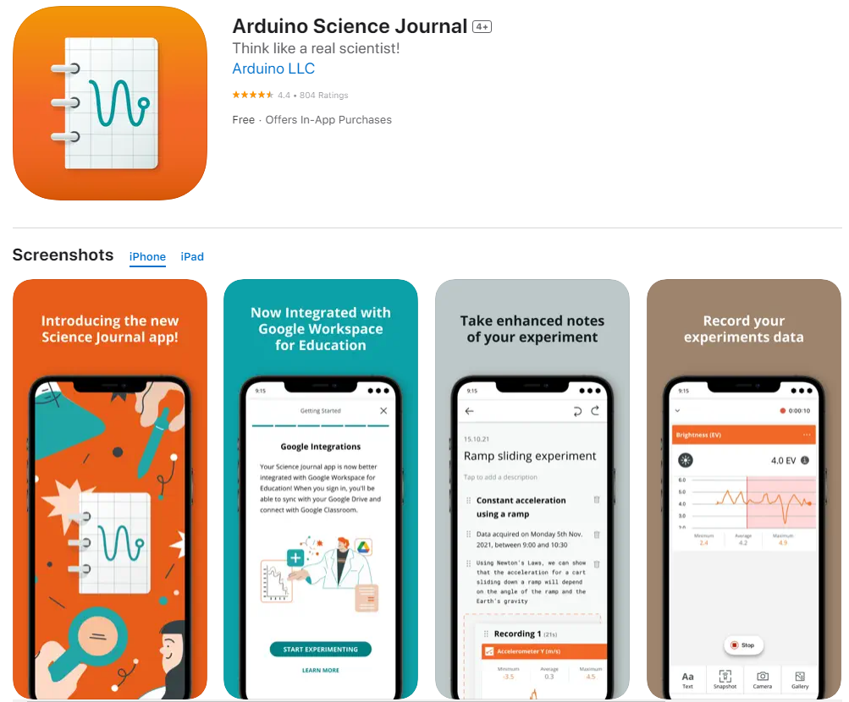
There’s an App for That
Use your smart phone’s sensors to take data at the fair!
https://www.arduino.cc/education/science-journal

Slide 13
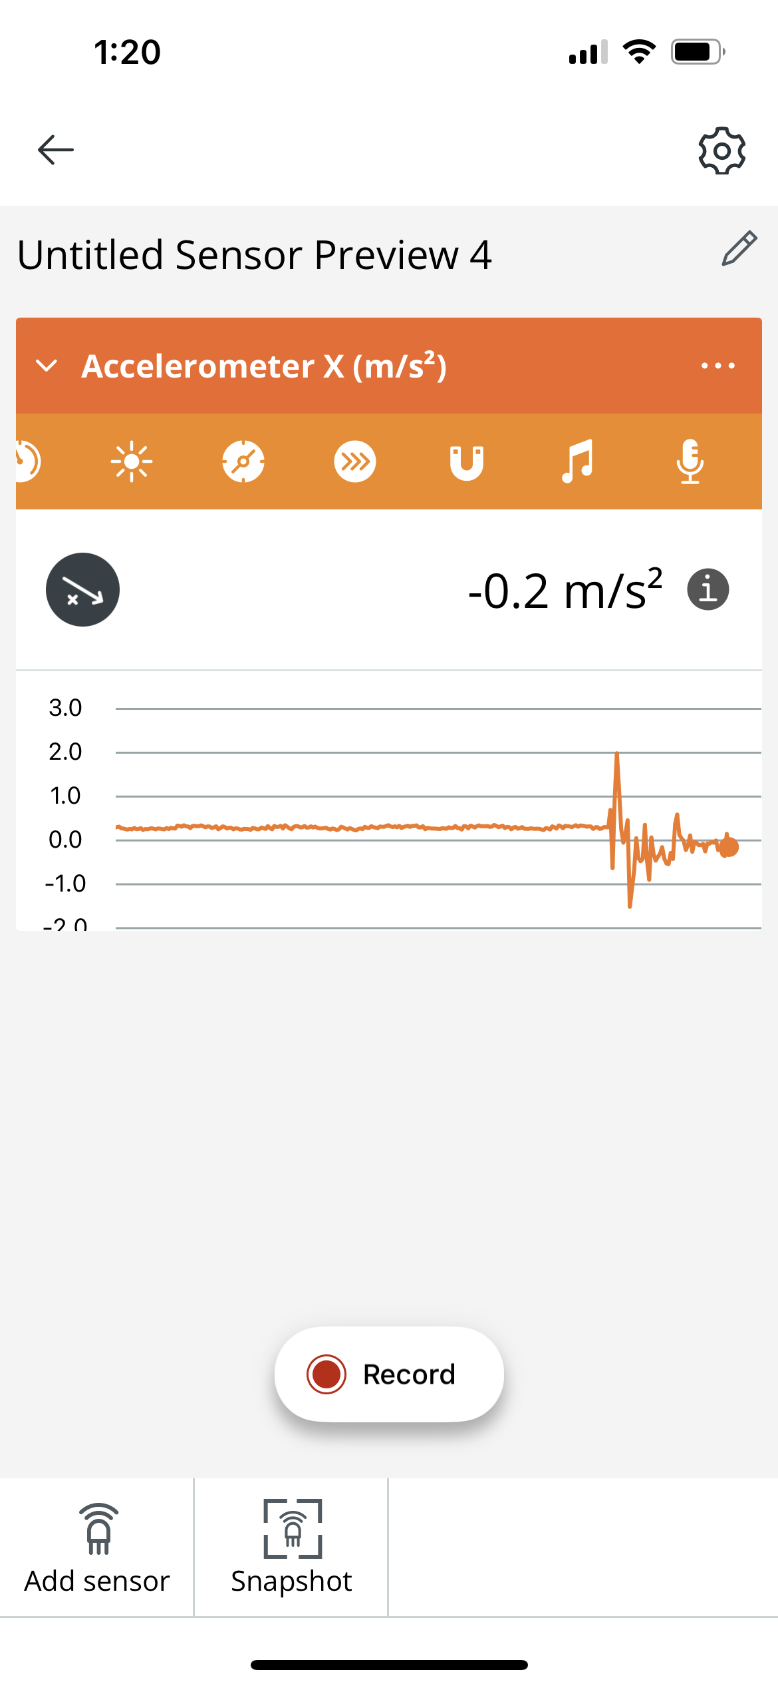
There’s an App for That
Use your smart phone’s sensors to take data at the fair!
https://www.arduino.cc/education/science-journal
An array of internal sensors to choose from.
When in doubt, click this. It will tell you exactly what is being measured and what sensor is used.
Allows you to measure multiple quantities at the same time
Record will save the numerical data
Only records the instantaneous value

Slide 14
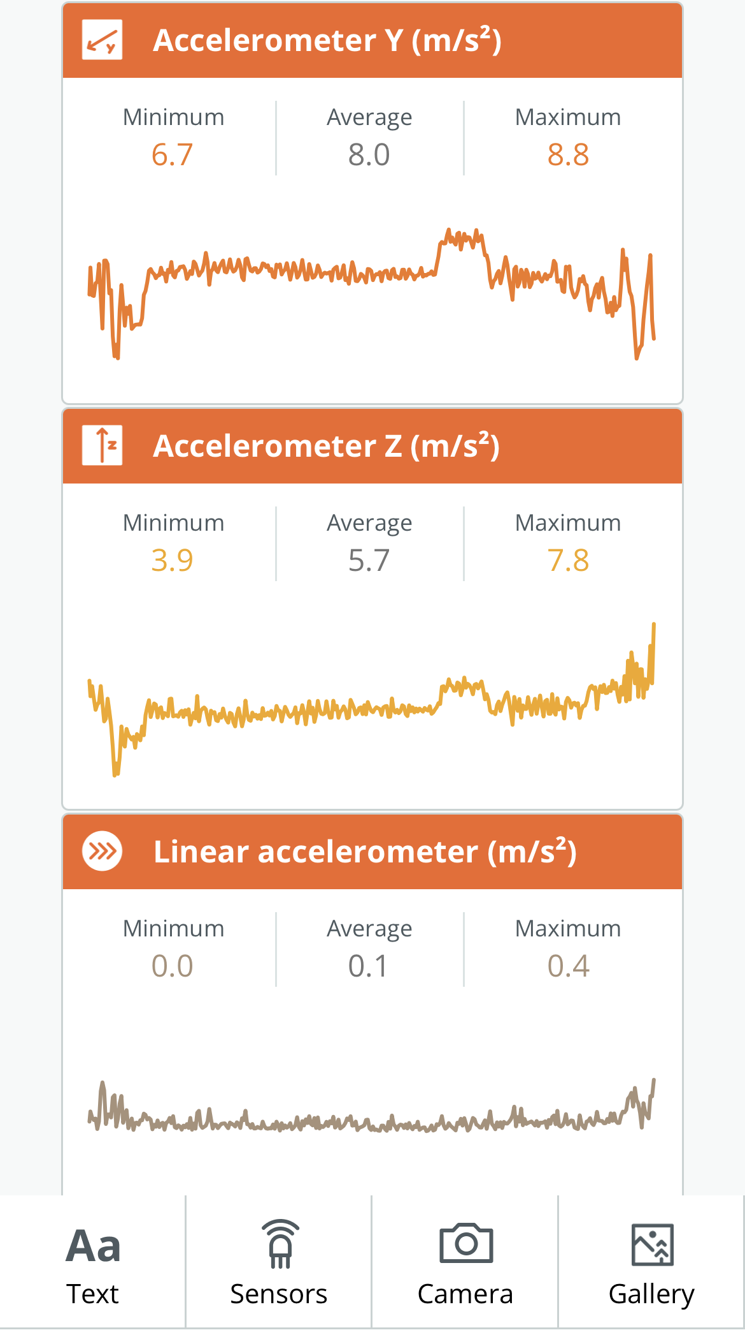
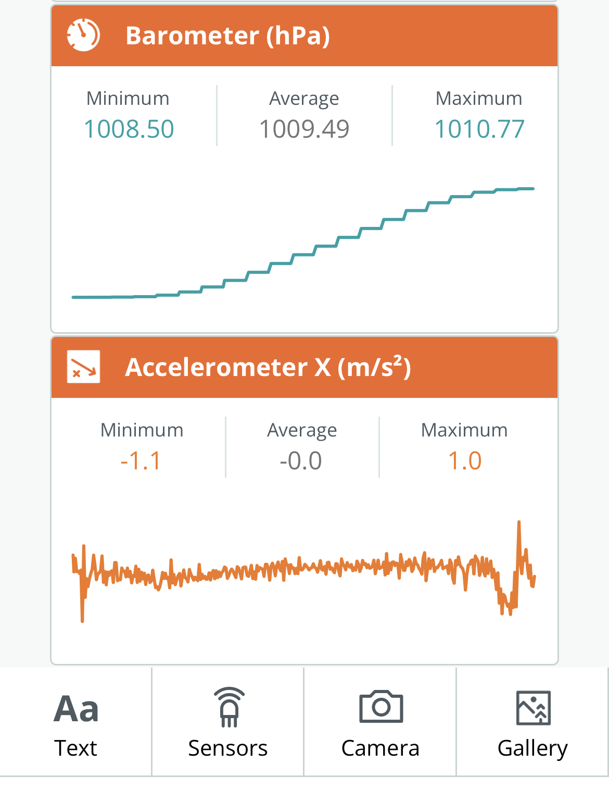
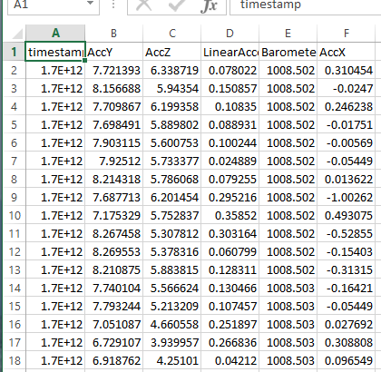
There’s an App for That
Ex. Recording of Yanwen’s elevator ride (From 5th floor to 1st floor in Jones) with 5 sensors selected
Data can be easily exported to a single Excel spreadsheet
* Make sure students understand which direction is x, y, and z with respect to the orientation of the phone. Figuring this out before coming to the fair will ensure the accuracy of their measurements at the fair.

Slide 15
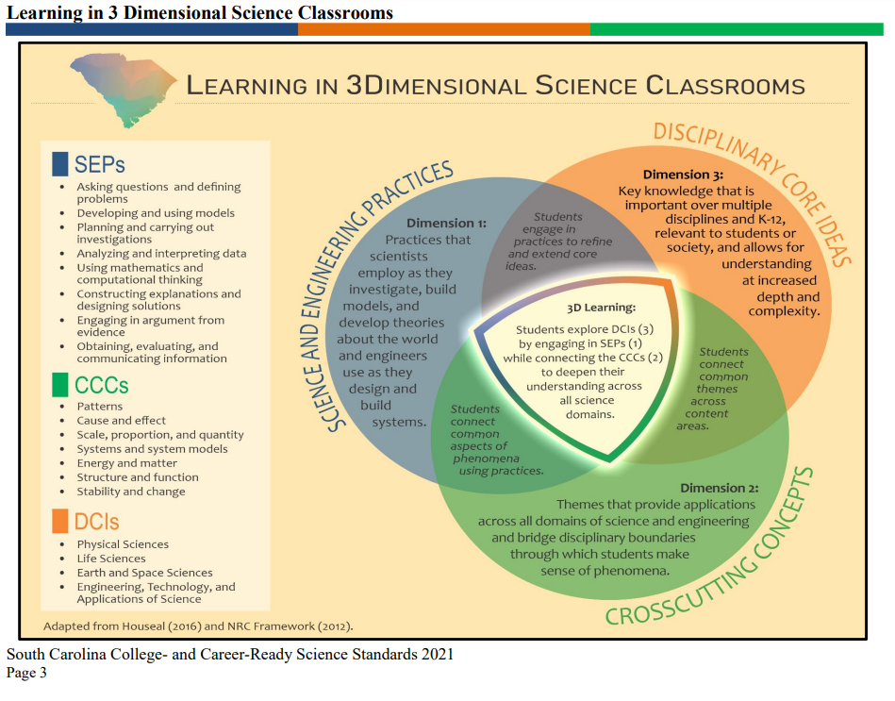

Slide 16
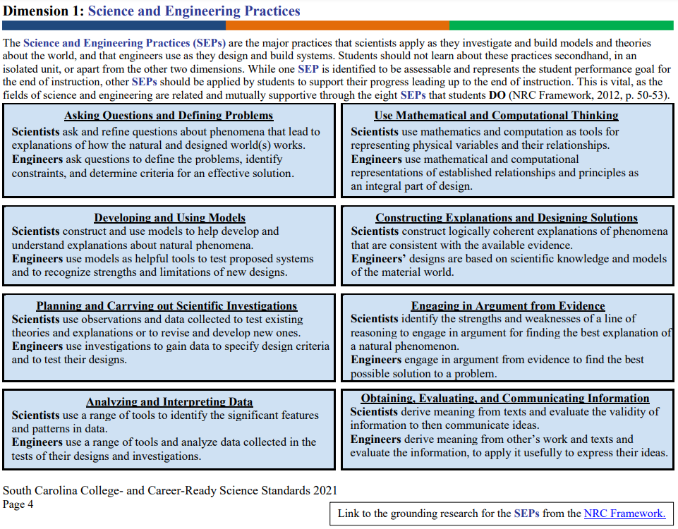

Slide 17
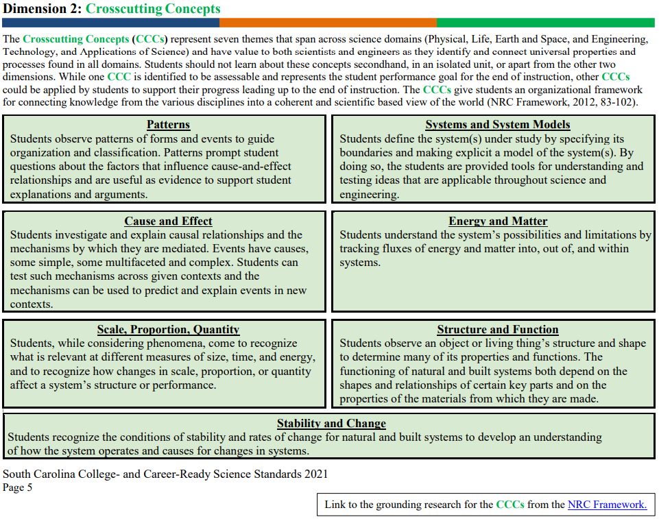

Slide 18
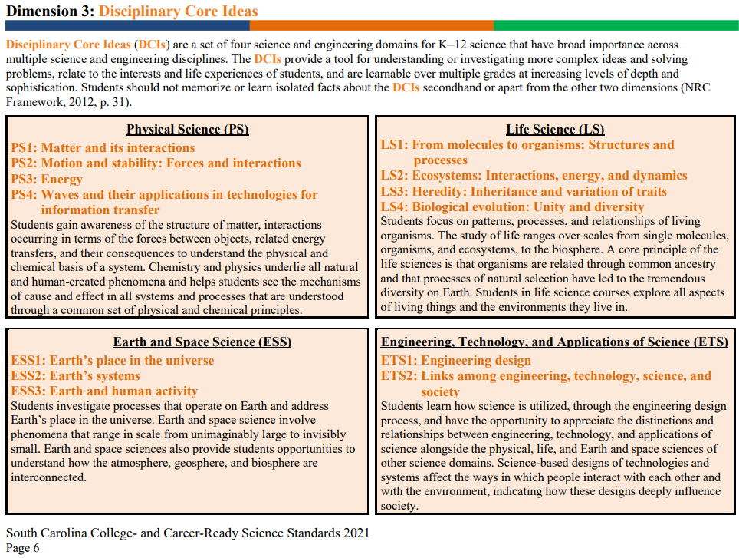

Slide 19
Printed Resources
Teachers Guide
Sample worksheets
​Midway Physics Day Website
State Science Standards

Slide 20
New Physics Concentrations!
Astronomy
Biomedical Physics
Please stay tune for more details on the USC Physics website!

Slide 21
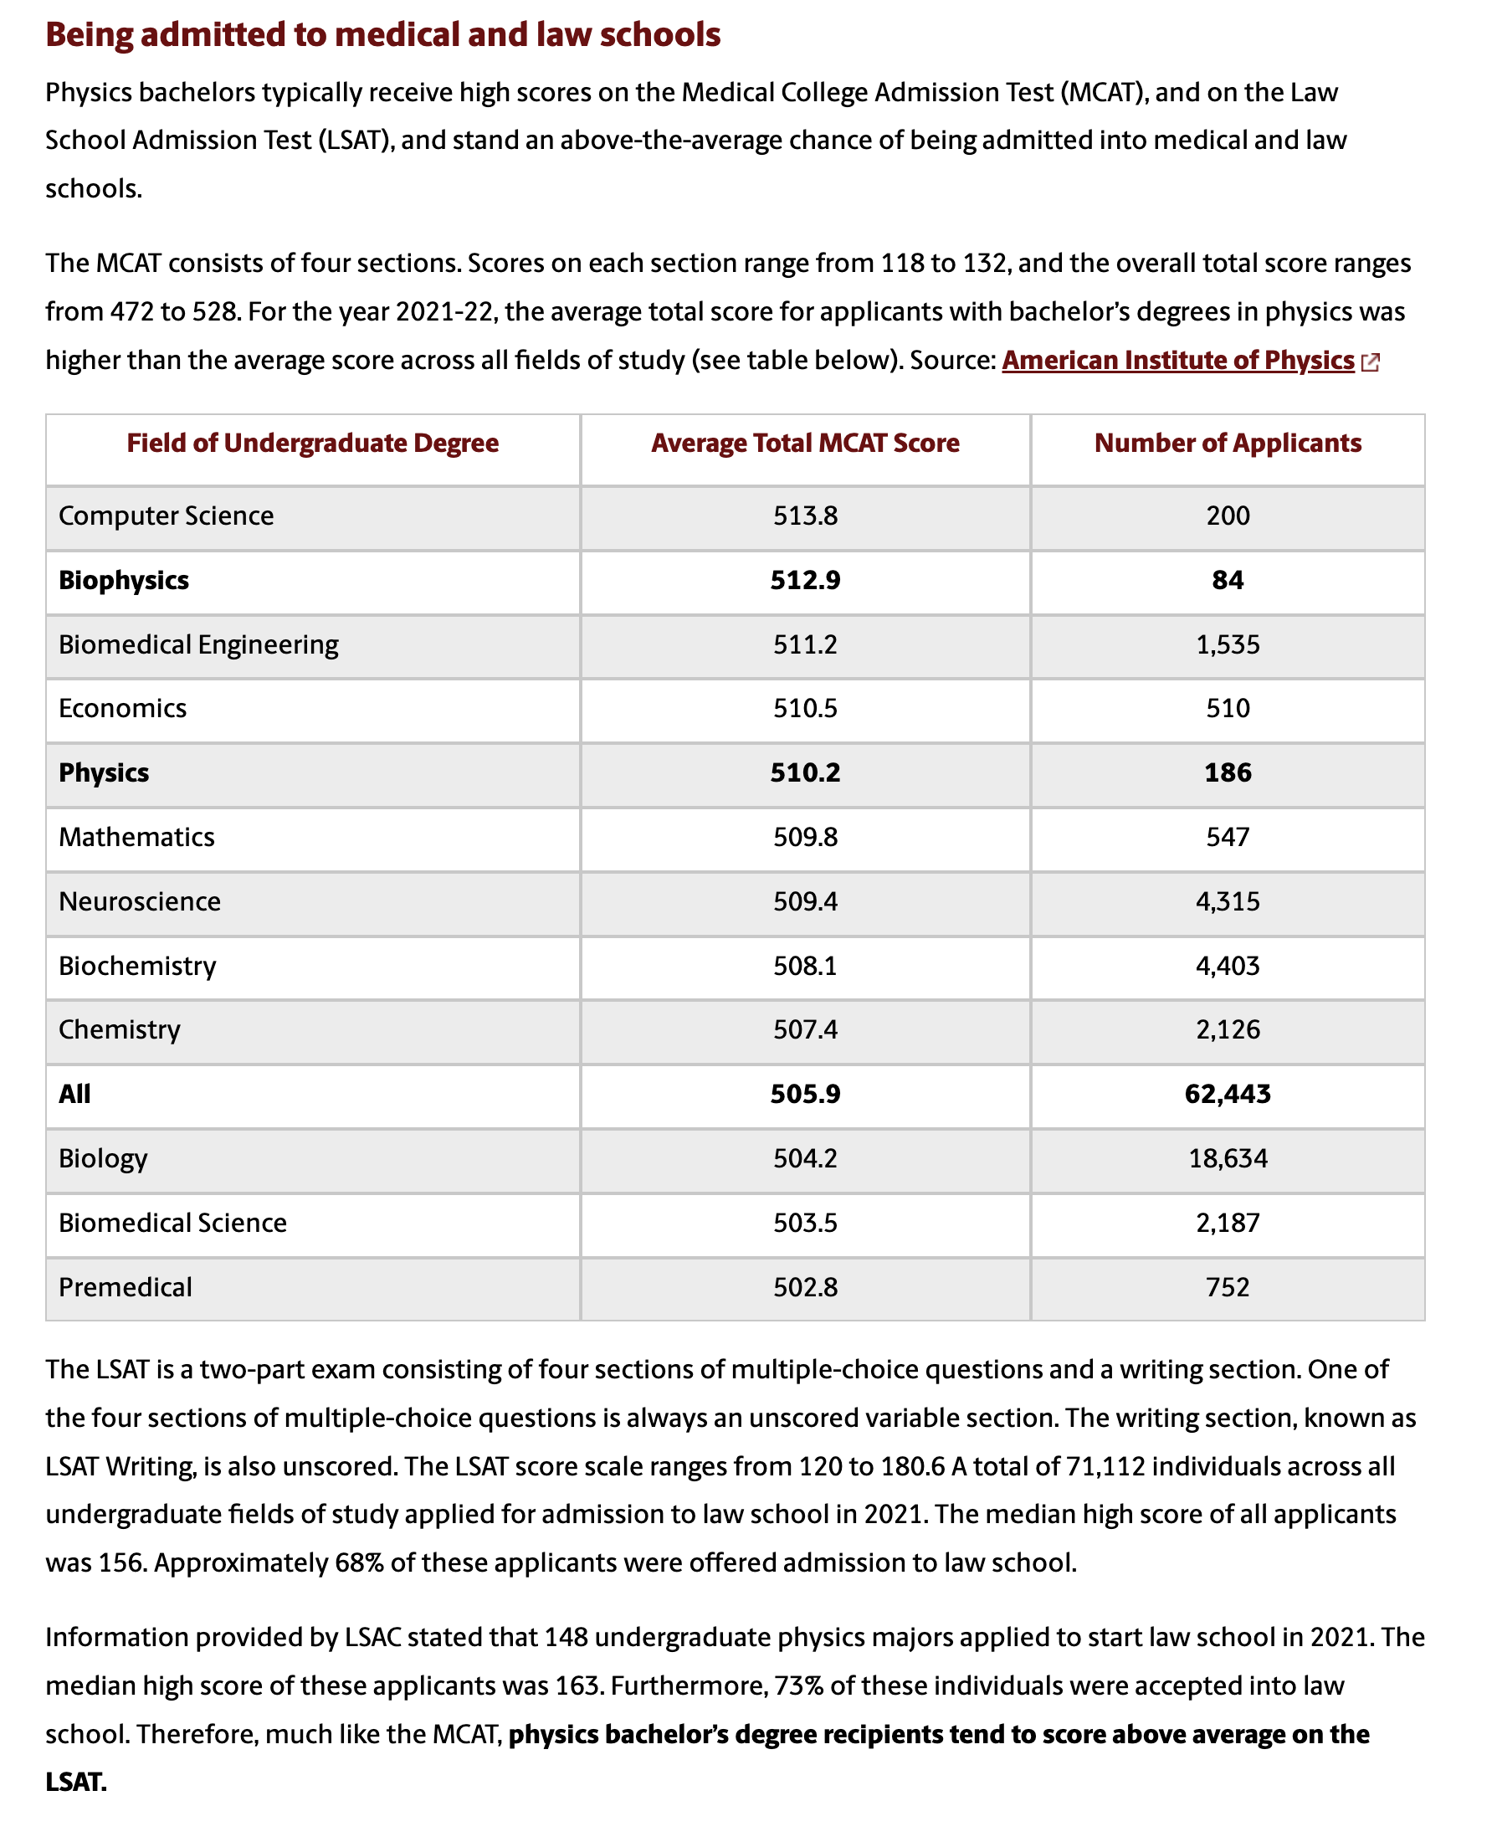
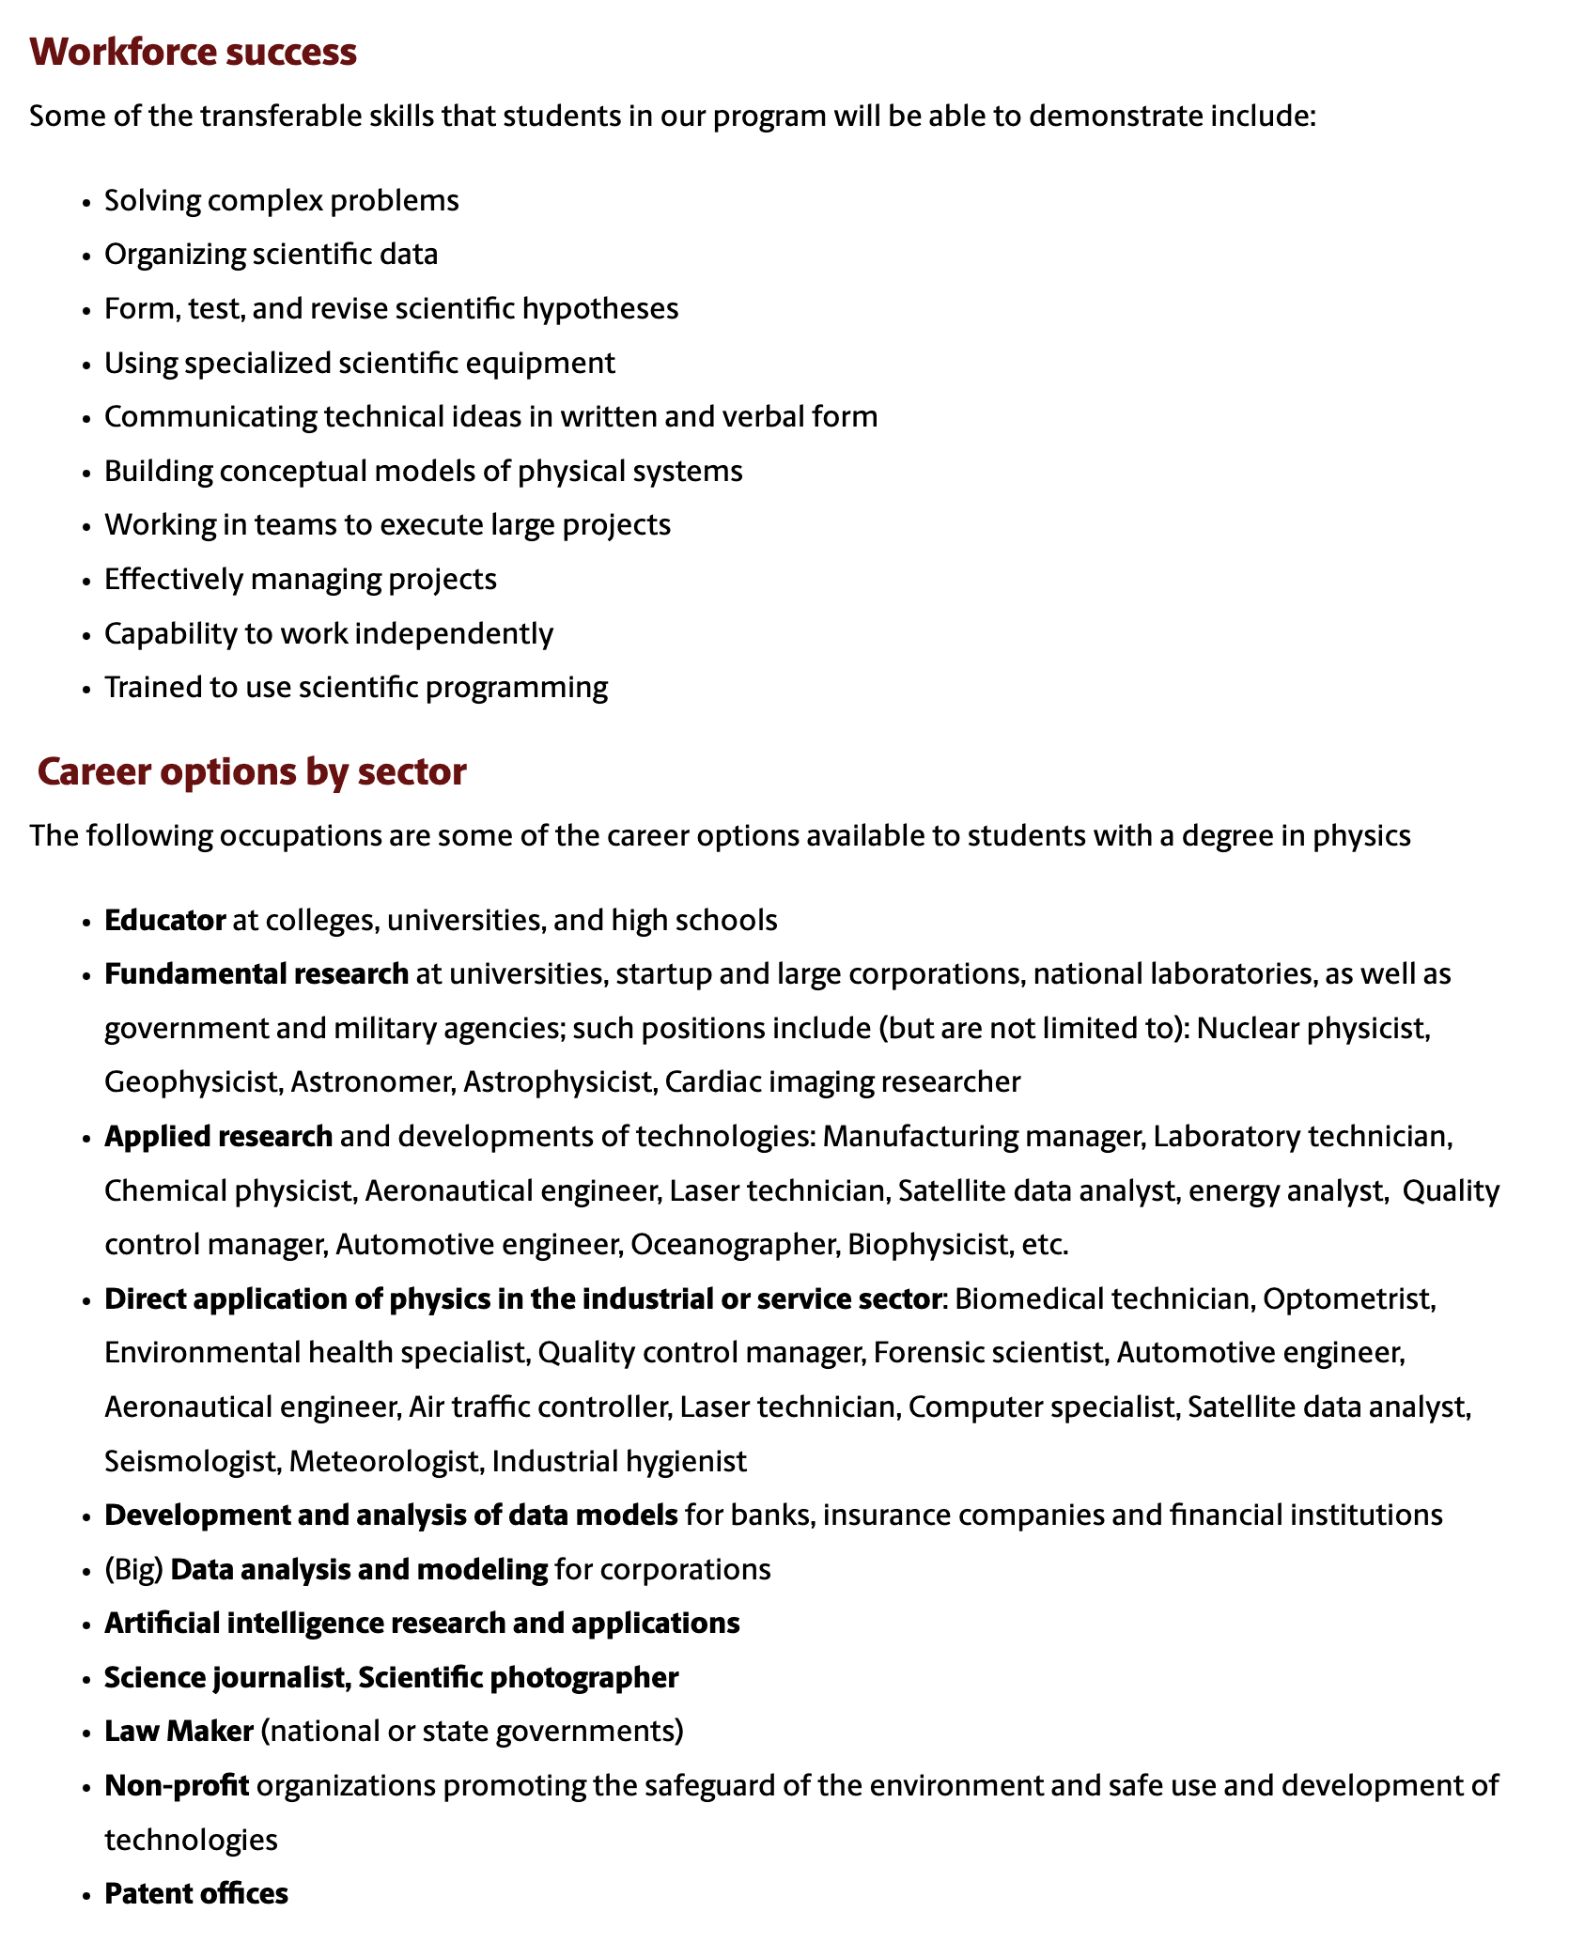

Slide 22
Final Thoughts
Midway Physics Day is a fun and effective way to motivate your class about science.
What else can we do to help improve this experience?
Questions??

Slide 23


Thanks! See you in 2 weeks!
Yanwen Wu and Nancy Kesar
Student Services Coordinator
803-777-8105

