Slide 1


Graduate School
Notes:
Ann begins, gives a nutshell of WHAT will be shared and WHY, then pitches it to Stacey for background.

Slide 2
1
Close look at the process, followed by idea generation
2
Survey to hear from customers and partners
3
Narrowing in on an action set of meaningful improvements
Notes:
Stacey provides a brief three-point overview of what has been done so far.

Slide 3
Notes:
Stacey shows (on this slide and the next) the detail with which the group looked at its process in its first round of work.

Slide 4
Notes:
Part 2 (of 2) of the process map

Slide 5
2
Survey to hear from customers and partners
779 respondents
671 students and applicants
108 partners
53 graduate directors, 13 assistant/associate deans
Thorough, thoughtful review and idea generation
Notes:
Stacey shares some key points regarding the survey – and emphasizes how the full GS team studied individually studied the input and identified needle-moving recommendations.

Slide 6
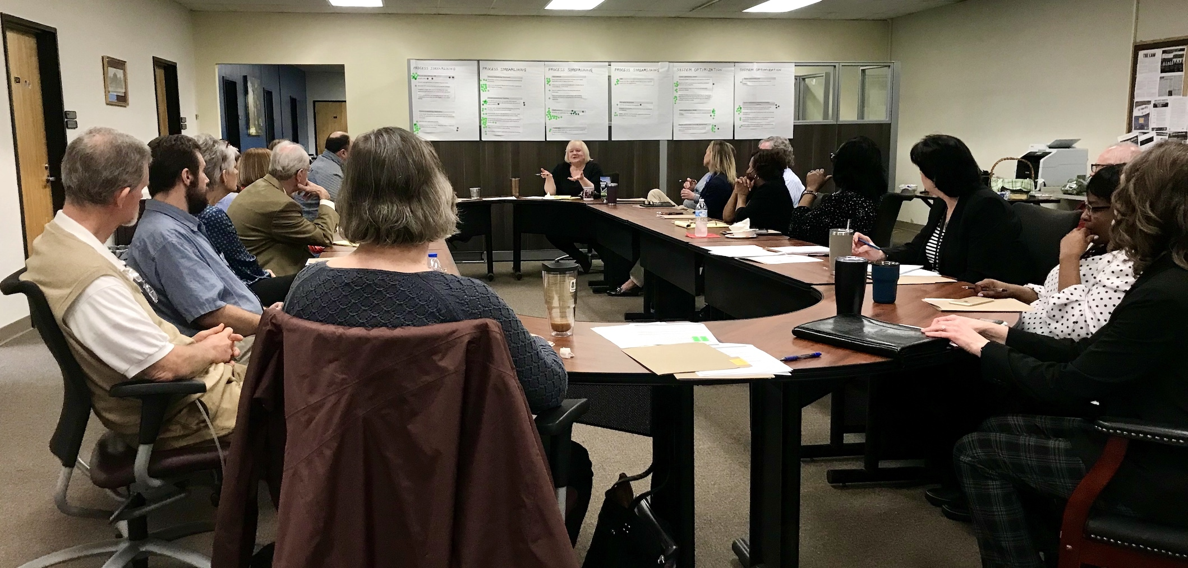
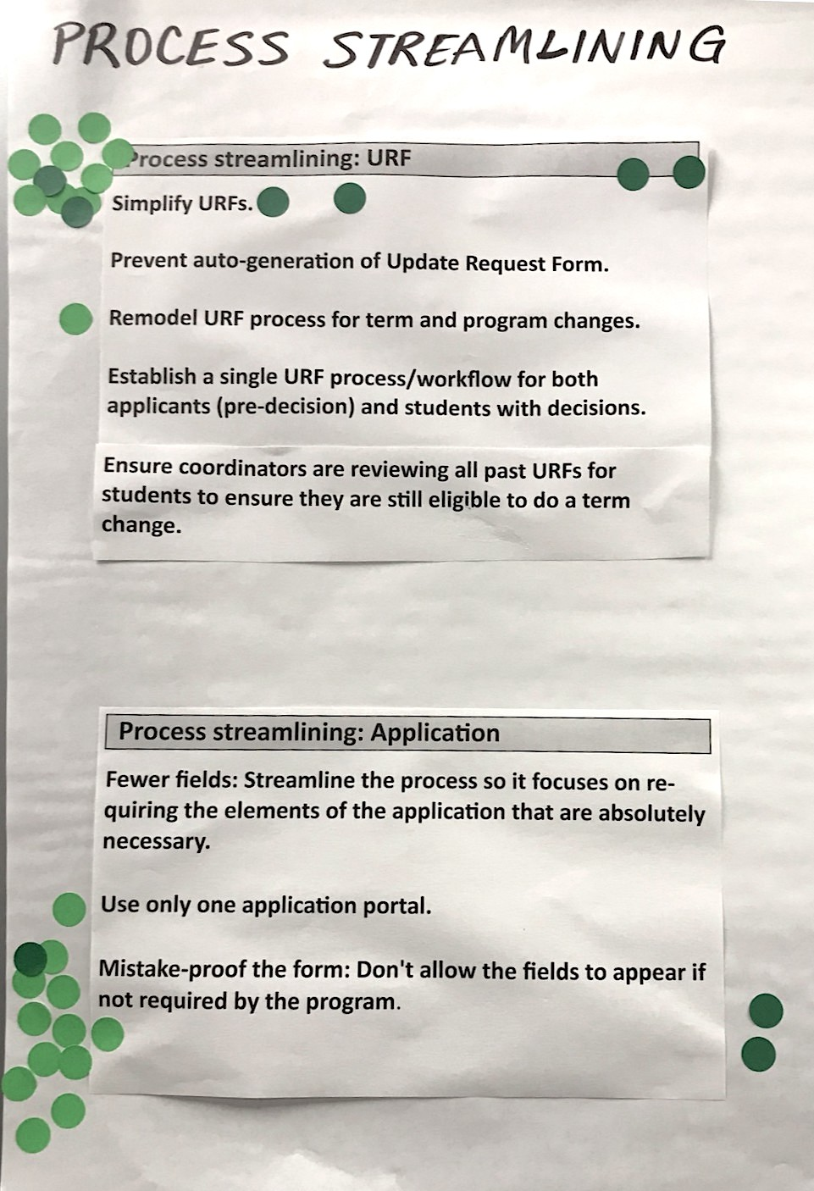
3
Narrowing in on an action set of meaningful improvements
Notes:
Stacey concludes on this slide, providing a very quick overview of what was done to narrow in – and then pitches it to Ann, who provides some further commentary on how everyone leaned into this exercise in order to further hone the action set.

Slide 7
3
Narrowing in on an action set of meaningful improvements
Serving applicants and students
Process Streamlining
Collaborating and communicating with departments and programs
System Optimization
Notes:
Ann notes how the emerging improvement actions fit into four categories. The two on the left are about people – and the two on the left are more about the process and systems aspects. In this way, the emerging set of proposed improvements is very balanced.

Slide 8
Narrowing in on an action set of meaningful improvements
Emerging action ideas based on feedback to date
Serving applicants
and students
Provide a single comprehensive checklist for all application requirements.
Develop automated application tracking to include checklists, communication as every step is completed, and ability for applicant to check status.
Develop consistent messaging to ensure programs and Graduate School are communicating the same information to students.
Provide clearer communication with International students regarding requirements/conditions in their admission letter.
Develop on-demand videos to help students navigate the respective application portals.
Process Streamlining
Collaborating and communicating with departments and programs
System Optimization
Notes:
Ann briefly shares ideas in this first category of serving applicants and students. (Of course, you’ll dwell on any points that are likely to resonate the most with the audience – and in fact, with some of these action items, you might even breeze by them quickly in order to give more air time to a significant few.)

Slide 9
Narrowing in on an action set of meaningful improvements
Emerging action ideas based on feedback to date
Serving applicants and students
Process Streamlining
Clarify Graduate School and Program responsibilities.
Create onboarding and training processes for graduate directors and department program managers.
Develop training manual for Graduate School Coordinators.
Establish periodic meetings (monthly or quarterly) between Graduate School and programs.
Colleges/schools: Require those involved in Graduate Admissions to attend an annual (re)training session.
Collaborating and communi-cating with departments and programs
System Optimization
Notes:
Ann briefly shares ideas in this first category of serving applicants and students. (Of course, you’ll dwell on any points that are likely to resonate the most with the audience – and in fact, with some of these action items, you might even breeze by them quickly in order to give more air time to a significant few.)

Slide 10
Narrowing in on an action set of meaningful improvements
Emerging action ideas based on feedback to date
Process Streamlining
Simplify the URF process.
Establish timelines for submission of accurate AAR program recommendations that cite any transcript, test score or other conditions.
Mistake-proof the application form. (e.g., don't allow the fields to appear if not required by the program)
Recommend reinstating the application fee.
Serving applicants and students
Collaborating and communicating with departments and programs
System Optimization
Notes:
Ann briefly shares ideas in this first category of serving applicants and students. (Of course, you’ll dwell on any points that are likely to resonate the most with the audience – and in fact, with some of these action items, you might even breeze by them quickly in order to give more air time to a significant few.)

Slide 11
Narrowing in on an action set of meaningful improvements
Emerging action ideas based on feedback to date
Serving applicants and students
Process Streamlining
Determine ways to streamline/integrate the multiple technology systems used for graduate admissions.
Integrate third-party application systems to directly connect to BDMS.
Provide Graduate School direct access to SLATE for transcripts sent through SPEEDE to Undergraduate Admissions.
System Optimization
Collaborating and communicating with departments and programs
Notes:
Ann briefly shares ideas in this first category of serving applicants and students. (Of course, you’ll dwell on any points that are likely to resonate the most with the audience – and in fact, with some of these action items, you might even breeze by them quickly in order to give more air time to a significant few.)

Slide 12
1
Close look at the process, followed by idea generation
2
Survey to hear from customers and partners
3
Narrowing in on an action set of meaningful improvements
4
Finalize the action set
and begin implementation
Notes:
Ann summarizes the work that has been done so far – and highlights the current phase of finalizing the action set.

Slide 13
Below is one option to engage the group. Or you could go with a single question – the “Your Advice” question below. Or you might have another idea in mind.
THUMBS-UP
What are you hearing that you really like?
CONCERN
What are you hearing that gives you pause?
YOUR ADVICE
What’s your advice on how we can keep this moving and ensure that it leads to meaningful improvement and results?

Slide 14
Graduate School
Notes:
Ann concludes the session.

